Slide 1
Principles of Data Science
Li Niu

Slide 2
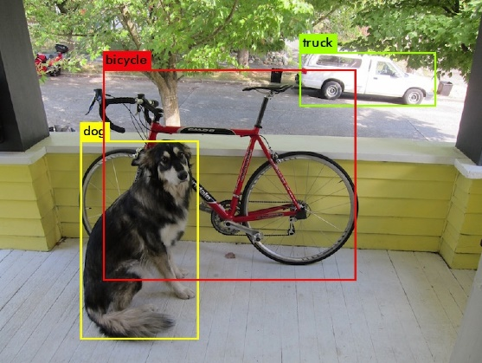
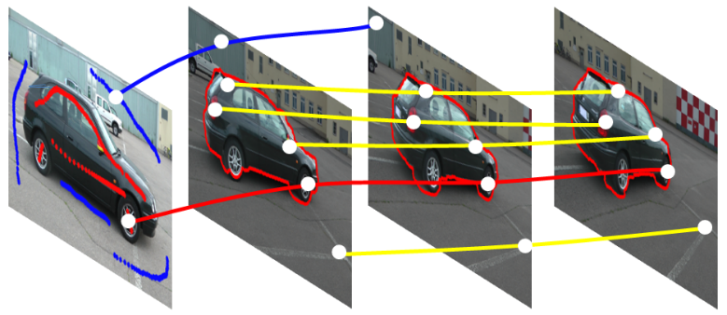
Local descriptors
An image or video can be treated as a bag of local descriptors.
An image has many object proposals.
The feature of each object proposal is a local descriptor.
A video has many trajectories.
The feature of each trajectory is a local descriptor.

Slide 3
Feature encoding
Encode each bag of local features into a feature vector based on codebook.
Step1: learn a codebook
Step2: encode local descriptors based on the learnt codebook

Slide 4












Feature encoding
Step1: learn codebook
bags of
local features
codebook
a pool of local features

Slide 5

Feature encoding
Step2: encode local features
bags of
local features
encoded feature
codebook

Slide 6
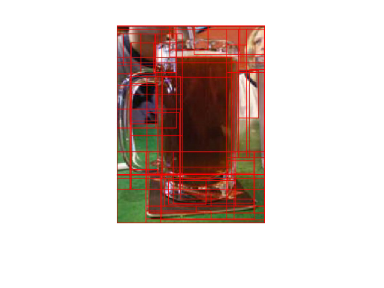
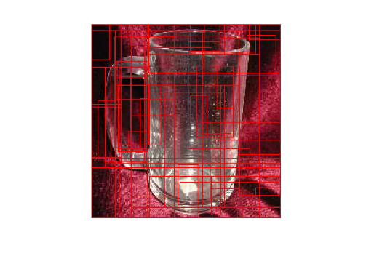
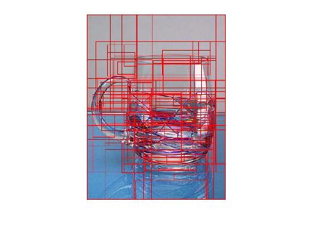
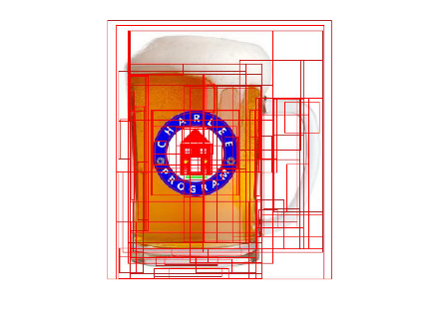
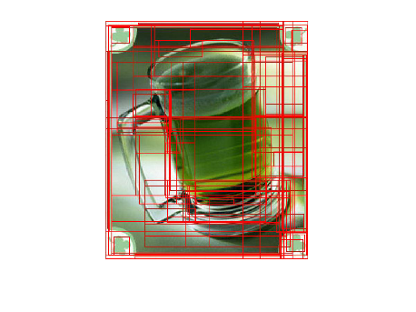
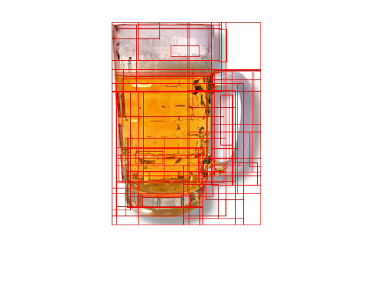
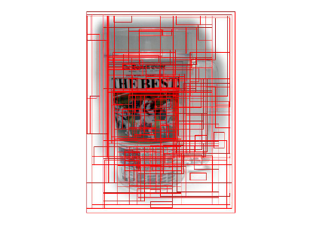
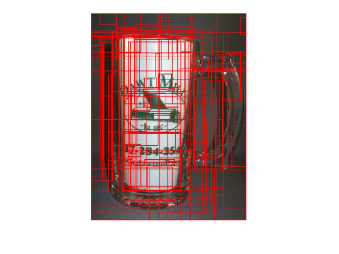
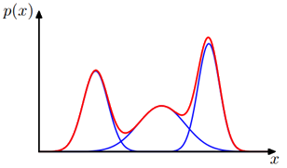








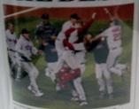





Example
extract proposals
codebook
learn codebook

Slide 7

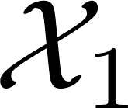

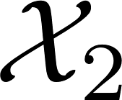


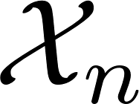
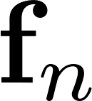
Example
encoding
…
codebook
…

Slide 8
Feature encoding
Encode 0-order information
e.g, bag-of-word (BOW)
Encode 1-order information
e.g., Vector of Locally Aggregated Descriptors (VLAD)
Encode 2-order information
e.g., Fisher vector

Slide 9
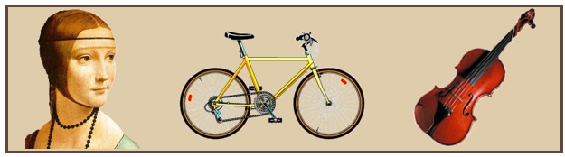
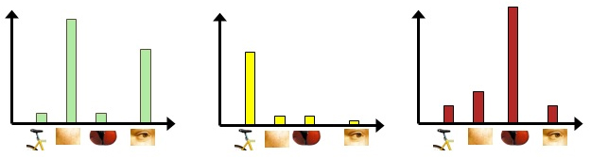
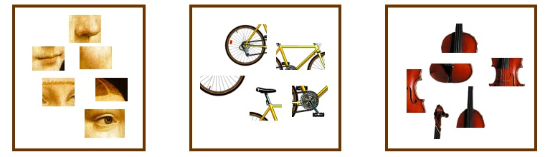
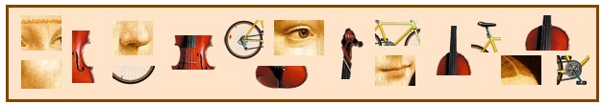





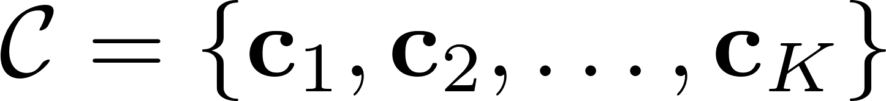
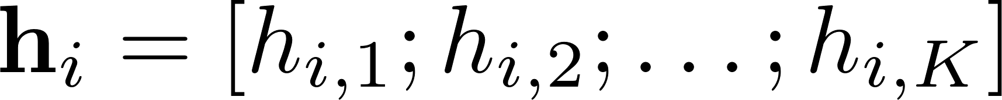
Bag-of-word (BOW)
codebook
cluster
codebook
bag of local descriptors
encoded feature

Slide 10



Vector of Locally Aggregated Descriptors (VLAD)
codebook
( - )+( - )+( - )+( - )
( - )+( - )

Slide 11
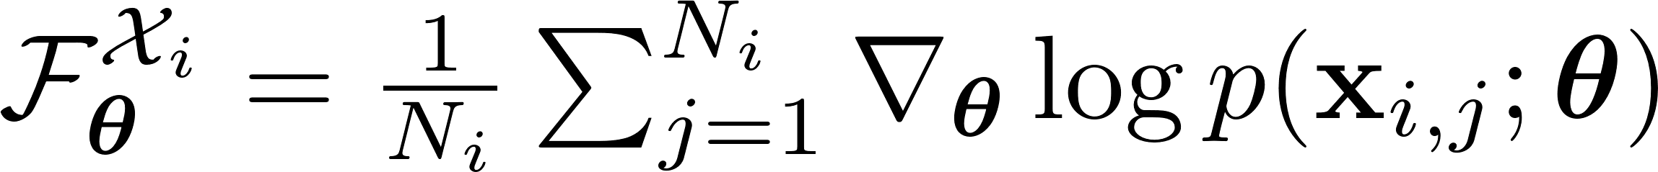
Fisher Vector
GMM (K=3)

Slide 12
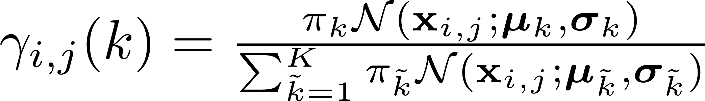
Fisher Vector
mean (d-dim)
diagonal covariance (d-dim)
2Kd-dim Fisher vector:
2d-dim component
K components

Slide 13




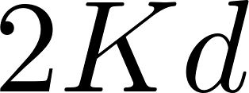
Feature encoding
BOW:
(0-order information)
-dim
VLAD:
(1-order information)
-dim
Fisher vector:
(1-order + 2-order information)
-dim
Other feature encoding methods:
Super vector (0-order + 1-order information)
….

Slide 14
Thanks!

